Slide 1
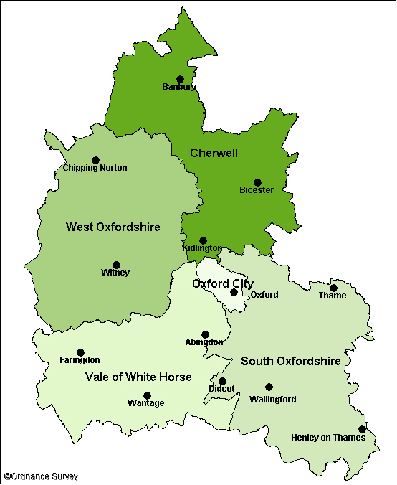
Chipping Norton
Saturday 6th May – Coronation Day
The British Legion will mark the event at 10:00am at the flagpole in the Millennium Gardens on West Street. An augmented team of bellringers are preparing to ring the bells at St Mary’s Church at various key times over the weekend.
Sunday 7th May – The Coronation Big Lunch
Chipping Norton Town Council (CNTC) is organising a ‘Picnic in the Park’ event at the New Street Recreation Ground – More info : King's Coronation Weekend - Picnic in the park (07 May 23) - Chipping Norton Town Council (chippingnorton-tc.gov.uk)
Monday 8th May – The Big Help Out
Chipping Norton News has asked for details of any events/activities/opportunities to be emailed to them at chippymail@aol.com by 7th April and they will publish them in the May edition (out on 24th April) and on their Facebook page.
Chadlington
Saturday 6th May – Coronation Day
An augmented team of bellringers are preparing to ring the bells at St Nicholas’ Church at various key times over the weekend.
Sunday 7th May – The Coronation Big Lunch
Chadlington Parish Council (CPC) is organising a village event around the Memorial Hall from Midday until early evening
Banbury
Coronation Celebration Day on Sunday 7th May from 12:00 -21:00 at Spiceball Park, Banbury more info at: Coronation Celebrations (May) - Banbury Town Council
10th May, Banbury Town Hall 18:30 – 20:30 – Multi Faith Group for an evening of songs and dance
Bicester
Coronation Picnic, The Garth, Bicester – timings TBC, ore info at: The Coronation picnic at Garth park, Bicester – Coronation of His Majesty The King & Her Majesty The Queen Consort
Bicester Town Council Coronation Church service at St Egburgs Church information: 0189 252915
Kidlington
6th May – Public viewing of the Coronation at Exeter Hall
7th May – Big Lunch at Exeter Hall
Oxford City
Coronation Cream tea at St Lawrence Church, North Hinksey - More info at: https://coronation.gov.uk/events/
Bring and Share Lunch – Barton Sat 7th
Barton Community Centre – Sunday 8th Party – more info from: susanholden@hotmail.com
The Ley’s fete has been rescheduled – contact ewa@opaoxford.org
Monday 8th May, Flo’s – The Place in the Park – East Oxford’s Volunteers - Celebrating East Oxford's Volunteers Day Tickets, Mon 8 May 2023 at 12:30 | Eventbrite
Coronation Big Lunch, Sunday 7th May at Asian Cultural Centre - https://www.eventbrite.co.uk/e/coronation-big-lunch-oxford-interfaith-community-lunch-tickets-601584093217
Weston on the Green
Afternoon Tea on Saturday – details TBC
Charlbury
Community big Lunch at Nine Acres on Sunday 7th May, more info at: Celebrate our Charlbury community for the King’s Coronation – Charlbury Town Council (charlbury-tc.gov.uk)
The Big Help Out - Local charities have been invited to take a stall in order to encourage people to volunteer with them, tea and cake will be provided. There will be activities for the Children in the community also. The event will take place in the Local Village Hall and gardens. Currently 22 stalls have signed up, the local scouts and guides will be in attendance.
Thame
Events TBC - Festivals and Events - Thame Town Council
Dorchester-on-Thames
The Big Dorchester street party with entertainment. Hosted by Dorchester Parish Council on Queen Street, on Sunday 7 May from 3pm – 8pm – More information available on the Dorchester Parish Council webpage.
Witney:
Saturday 6th May Timings TBC
Screening of Coronation, Corn Exchange
Best Shop Window Judging, Town Centre
Children’s make and play event
Sunday 7th May
Coronation Civic Service, St Mary’s Church Green 10:45
The Big Lunch, The Leys 12:00 – 17:00
Free Screening of the Coronation Concert – Corn Exchange Timings TBC
More info at: Witney-Celebrates-the-Coronation-1.png (1587×2245) (witney-tc.gov.uk)
Wallingford
Coronation Celebrations. Hosted by Wallingford Town Council at The Castle Gardens, Wallingford from 6 – 8 May – More information available on the town council website.
Henley
Kings Coronation Celebration with a large TV and entertainment. Hosted by Henley Town Council at Henley Market Place, from Saturday 6 – 8 May from 10am – 5pm – More information available on the town council website.
Monday 8th May - Henley Coronation Flotilla and Charity Stands along the river
Faringdon
Music in the Market Place on Saturday 6th May (events from 14:30 – 21:00) – more info at: Music in the Market Place to celebrate the King's Coronation - Faringdon Town Council
Wantage
Family Coronation Day, Wantage Market Square, 10:00 – 18:00 more info at Events for April 2023 – Wantage Town Council
Didcot
Coronation Barn Dance. Hosted by Didcot Town Council at Didcot Civic Hall on Saturday 29 April from 7pm – 11.30pm – More information available on the town council events webpage.
Kings Coronation Celebration with entertainment. Hosted by Style Acre at Boundary Park, Didcot, on Saturday 6 May from 2pm – 11pm – More information available on the Style Acre Facebook page.
Fernham
Open House at The Woodman Pub to watch the Ceremony on 6th May
Community Big Tea on 7th May with village games
Shrivenham
Party on The Rec! – Sunday 7th May 12:00 – 17: 00
Abingdon
Coronation Bun Throwing, Abingdon Market Place on Sunday 7th May at 16:00
Coronation Service, 5th May 2023 at 7.30pm
in St Helen’s Church, Abingdon

