Slide 1
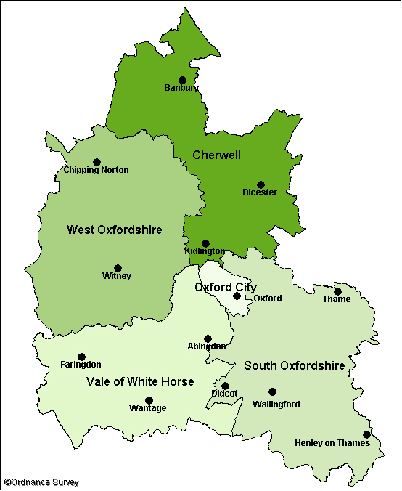
Appleton, Eaton and Besselsleigh
SATURDAY 6TH MAY
APPLETON VILLAGE HALL
10.30am – 2.00pm
Watch the Coronation
2.00pm – 4.00pm
Free Family Treasure Hunt
From 5.00pm
Pig Roast and presentation of prizes for the
Treasure Hunt.
SUNDAY 7TH MAY
ST LAURENCE CHURCH,
A special All Age Service
to celebrate the
King’s Coronation
10.00am
SOUTH LAWN, NETHERTON ROAD, APPLETON
1.00pm – 5.00pm
The King’s Coronation Big Picnic Lunch and Celebration Tea
CRAFTS FOR ADULTS AND CHILDREN
Make yourself a Coronation crown, rosette or decorated bottle – all materials provided.
DRESS TO IMPRESS AND TAKE THE CROWN!
Unleash your creativity and steal the show with a fabulous costume in our fun competition
for adults and children.
CORONATION BAKE OFF
Can you be a champion baker? Bring your Coronation bakes and biscuits to the competition
tent by 2.30pm.
MONDAY 8TH MAY
11.30am – 2.00pm IN CHURCH ROAD
The Big Help Out
Highlighting the positive impact volunteering has across the nation.
Oxford City
Coronation Cream tea at St Lawrence Church, North Hinksey - More info at: https://coronation.gov.uk/events/
Barton Community Centre – Sunday 8th Party – more info from: susanholden@hotmail.com
The Ley’s fete has been rescheduled – contact ewa@opaoxford.org
Monday 8th May, Flo’s – The Place in the Park – East Oxford’s Volunteers - Celebrating East Oxford's Volunteers Day Tickets, Mon 8 May 2023 at 12:30 | Eventbrite
Coronation Big Lunch, Sunday 7th May at Asian Cultural Centre - https://www.eventbrite.co.uk/e/coronation-big-lunch-oxford-interfaith-community-lunch-tickets-601584093217
Thame
Events TBC - Festivals and Events - Thame Town Council
Dorchester-on-Thames
The Big Dorchester street party with entertainment. Hosted by Dorchester Parish Council on Queen Street, on Sunday 7 May from 3pm – 8pm – More information available on the Dorchester Parish Council webpage.
Didcot
Coronation Barn Dance. Hosted by Didcot Town Council at Didcot Civic Hall on Saturday 29 April from 7pm – 11.30pm – More information available on the town council events webpage.
Kings Coronation Celebration with entertainment. Hosted by Style Acre at Boundary Park, Didcot, on Saturday 6 May from 2pm – 11pm – More information available on the Style Acre Facebook page.
Saturday 6th May - The Malborough, Didcot will be showing the coronation on a big screen and there will be afternoon tea served, bouncy castle, live music and a disco.
Sunday 7th May – The Big Harwell Coronation Picnic, Harwell Rec, live music, cream teas etc
Faringdon
Music in the Market Place on Saturday 6th May (events from 14:30 – 21:00) – more info at: Music in the Market Place to celebrate the King's Coronation - Faringdon Town Council
Fernham
Open House at The Woodman Pub to watch the Ceremony on 6th May
Community Big Tea on 7th May with village game
Shrivenham
:Party on the Re! – Sunday 7th May - 12:00 – 17: 00
Wallingford
Coronation Celebrations. Hosted by Wallingford Town Council at The Castle Gardens, Wallingford from 6 – 8 May – More information available on the town council website.
Saturday 6th May: Watch a screening of the coronation in the Castle Gardens with children’s crafts, stalls on Castle Street, a Punch & Judy show and more to celebrate. Timings to be confirmed when Buckingham Palace has announced the official time of the coronation.
We are looking for local stallholders to take part in this event - application link here: https://forms.gle/jxPh9CkAV31HWimU6
Sunday 7th May: Bring a picnic and listen to live music in the Castle Gardens from 1pm – 4pm.
Wantage
Family Coronation Day, Wantage Market Square, 10:00 – 18:00 more info at Events for April 2023 – Wantage Town Council
Henley
Kings Coronation Celebration with a large TV and entertainment. Hosted by Henley Town Council at Henley Market Place, from Saturday 6 – 8 May from 10am – 5pm – More information available on the town council website.
Monday 8th May - Henley Coronation Flotilla and Charity Stands along the river
Abingdon
Coronation Bun Throwing, Abingdon Market Place on Sunday 7th May at 16:00
Coronation Service, 5th May 2023 at 7.30pm
in St Helen’s Church, Abingdon

